Slide 1

Unwrapping Your Gifts
1 Corinthians 12:1-6
Dr. Rick Griffith • Crossroads International Church Singapore
cicfamily.com & BibleStudyDownloads.org
Notes:
1

Slide 2

Engine trouble…
“Pride goeth before destruction
and a haughty spirit before a fall”
Notes:
A pastor, Boy Scout, and IT expert once were the only passengers on a small plane. The pilot came back to the cabin and announced that the plane was going down but there were only 3 parachutes and 4 people. The pilot added, “I should have one of the parachutes because I have a wife and 3 small children.” So he took one and jumped.
The IT whiz spoke up next: “I should have one of the parachutes because I am the smartest man in the world and everyone needs me.” So he took one and jumped.
At this point the pastor turned to the young Scout. With a sad smile he said, “You are young and I have lived a long life, so you take the last parachute and I’ll go down with the plane.”
The Boy Scout said, “Relax, Reverend, the smartest man in the world just picked up my backpack and jumped!”
Thus the proverb is true: “Pride goeth before destruction—and a haughty spirit before a fall.”

Slide 3


“It's all about ME”
Notes:
People—and churches—too often get the idea that “it’s all about me.”

Slide 4
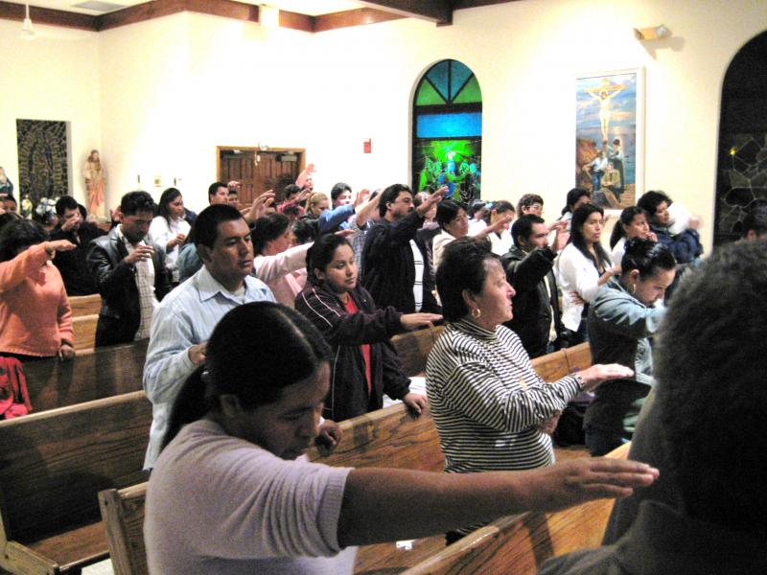
“It's all about us”
Notes:
I like that story because it’s a great reminder that it’s not about me—or even us.
Ultimately, all sin stems from pride—and churches can get proud over their size, worship, friendliness, music, teaching, small groups, money—or whatever.

Slide 5
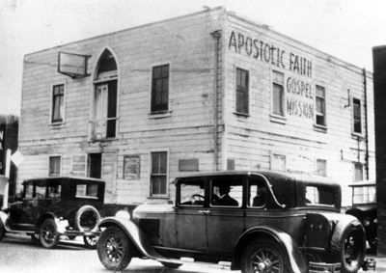
Pentecostal - 1901
Notes:
Today pride is often over whether a church is charismatic or non-charismatic.
This movement began in 1901 with Pentecostal churches speaking what they considered the biblical gift of tongues (speaking a language never learned).

Slide 6
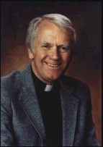
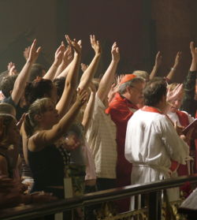
Charismatic - 1960
Dennis Bennett
Notes:
It spread to mainline churches in 1960 under Episcopal priest Dennis Bennett.

Slide 7

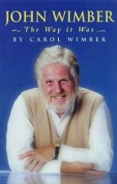

Third Wave - 1985
Notes:
In 1985 a saxophonist named John Wimber spread it into evangelical and Bible churches, including many Baptist, EFC, and now some Brethren groups.

Slide 8
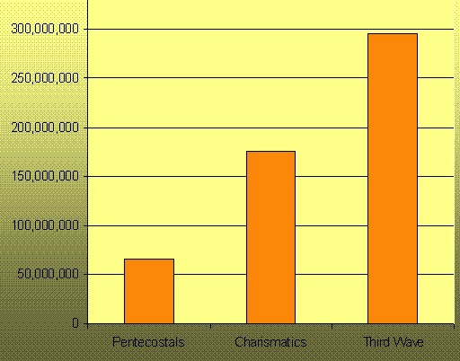
The Waves (1901-now)
Pentecostals
Charismatics
Third Wave
Notes:
Now the growth is simply amazing—and spiritual gifts are probably the most controversial of issues in the church today.

Slide 9
The Wayward Local Church
The Wayward Local Church
Reports
Questions
Division
Disorder
Difficulties
Concern
1–4
Discipline
5–6
Instruction
7–16
Carnality
3–4
Marriage 7
Worship
11–14
Factions 1–2
Incest 5
Idols 8–10
Resurrection
15
Immorality
Collection 16
Lawsuits 6
Solving church problems theologically

Slide 10


Spiritual Gifts
An Introduction

Slide 11

Spiritual Gifts
Where should we begin studying gifts?

Slide 12

I. Understanding gifts begins with seeing Christ as God (1-3).
Father
is
is not
is not
GOD
is
is
Son
Spirit
is not

Slide 13

1 Corinthians 12:1-3 (NIV)
¹Now about spiritual gifts, brothers, I do not want you to be ignorant.
²You know that when you were pagans, somehow or other you were led astray to mute idols.
³Therefore I tell you that no one who is speaking by the Spirit of God says, “Jesus be cursed,” and no one can say, “Jesus is Lord,” except by the Holy Spirit.

Slide 14
Black

Slide 15


Basic Issues in 1 Cor 12
2
What
Who
Where
When
Why

Slide 16
What are spiritual gifts?
2
"A spiritual gift is any ability that is empowered by the Holy Spirit and used in any ministry of the church"
Wayne Grudem,
Systematic Theology, 1016

Slide 17
What are spiritual gifts?
2
"…a God-given ability for service"
Charles Ryrie,
Basic Theology, 367
"…a spiritual capacity for development"
Earl Radmacher,
Sermon on Gifts

Slide 18
What are spiritual gifts?
2
Spiritual Gifts are Not:
Place of Service: the gift is the ability, not where the ability is used
Age Group Ministry: the gift is the ability, not who benefits from it
Natural Talents: the gift is the ability, not whether it came at birth
Spiritual gifts are only those mentioned in the Word of God

Slide 19

"Just as our bodies have many parts and each part has a special function, ⁵so it is with Christ’s body. We are many parts of one body, and we all belong to each other"
(Romans 12:4-5 NLT)

Slide 20
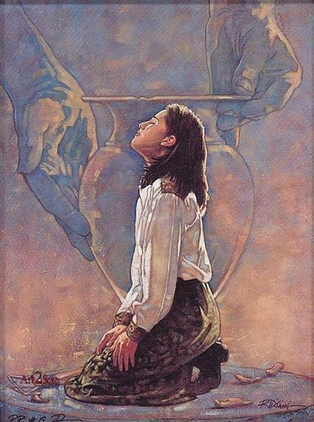
New Testament Gift Lists
6
Gifts (All) | Rom 12:6-8 | Eph 4:11 | 1 Cor 12:28 | 1 Cor 12:29-30 | 1 Cor 12:8-10
Teaching | Teaching |  | Teaching | Teaching
Evangelism |  | Evangelists
Pastor-Teacher |  | Pastor-Teachers
Encouraging | Encouraging
Administration |  |  | Administration
Faith |  |  |  |  | Faith
Giving | Giving
Service | Service |  | Helping
Showing Mercy | Mercy
Apostleship |  | Apostles | Apostles | Apostles
Wisdom |  |  |  |  | Wisdom
Knowledge |  |  |  |  | Knowledge
Prophecy | Prophecy | Prophets | Prophecy | Prophecy | Prophecy
Discerning Spirits |  |  |  |  | Discerning Spirits
Tongues |  |  | Tongues | Tongues | Tongues
Interpretation |  |  |  | Interpretation | Interpretation
Miracles |  |  | Miracles | Miracles | Miracles
Healings |  |  | Healings | Healings | Healings

Slide 21
Black

Slide 22
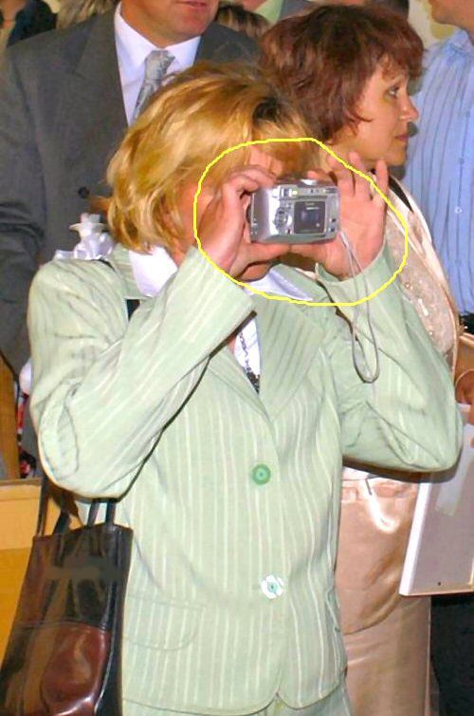
Me? Gifted?

Slide 23

Every Christian has a gift
"A spiritual gift is given to each of us so we can help each other"
(12:7 NLT)
"[The Spirit] gives them to each one, just as he determines"
(12:11 NIV)
"But our bodies have many parts, and God has put each part just where he wants it"
(12:18 NLT)

Slide 24


Have you unwrapped your gift yet?

Slide 25
Where, When & Why?
2
Where used?
When received?
Why given?

Slide 26
Every Christian got a gift when?
"A spiritual gift is given to each of us so we can help each other"
(12:7 NLT)
"[The Spirit] gives them to each one, just as he determines"
(12:11 NIV)
At salvation!
"But our bodies have many parts, and God has put each part just where he wants it"
(12:18 NLT)

Slide 27
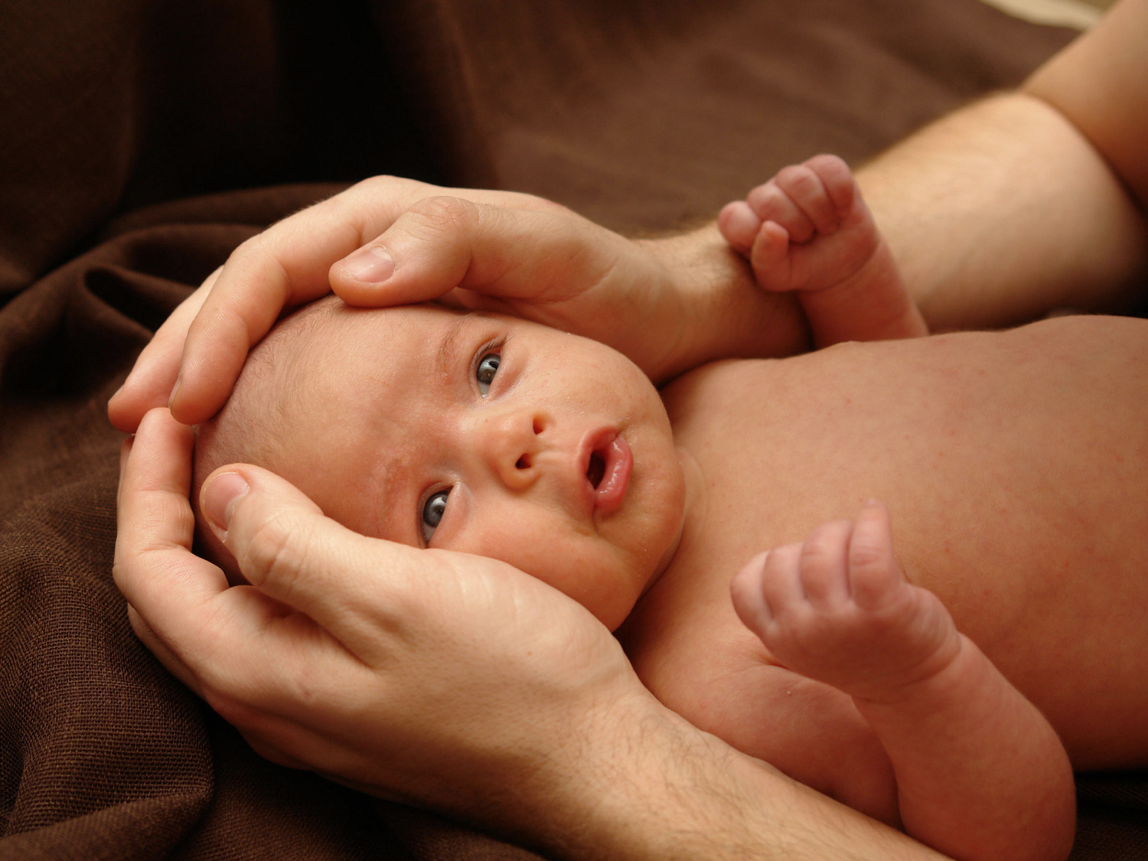
Black
Notes:
It’s like a baby. I remember when our first son was born. Kurt came fully equipped! Eyes, hands, legs, and belly button... Yet his eyes couldn’t focus, he couldn’t control his hands, the legs seemed useless the first few months.
When you trusted Christ, the Spirit gave you an ability to use for Him. But you were a baby in Christ—equipped but ignorant and unskilled in what you can do.

Slide 28
Black
Notes:
When you trusted Christ, the Spirit gave you an ability to use for Him. But you were a baby in Christ—equipped but ignorant and unskilled in what you can do.

Slide 29

Black
Notes:
Maybe a computer provides another analogy. You buy that computer with all the gadgets, but it takes years to understand and use all that it can do.

Slide 30
1 Corinthians 12:1-3 (NIV)
¹Now about spiritual gifts, brothers, I do not want you to be ignorant.
²You know that when you were pagans, somehow or other you were led astray to mute idols.
³Therefore I tell you that no one who is speaking by the Spirit of God says, “Jesus be cursed,” and no one can say, “Jesus is Lord,” except by the Holy Spirit.

Slide 31

Black
Notes:
Idols say nothing but gifted persons praise Christ as God (2-3).
Some of us here used to follow idols that couldn’t speak at all (2).
I’ve heard some of your stories how you were bound by joss sticks and the like.
A grandma on the other side of our semi-D had this problem. Once water flooded both of our homes—then the rain came the next day. As the water rose, I went out to try to prevent flooding again. She was in overdrive with her joss sticks on the porch “influenced and led away to mute idols.” I put boards up to divert the rain!

Slide 32

Jesus Christ is Lord = God
Notes:
But now the Holy Spirit leads us—and He affirms Christ’s deity (3).
The caution in verses 2-3 is against assuming that all manifestations that look like spiritual gifts are from God. Satan is a master counterfeiter. The gifts can be and are counterfeited by many present sects and religions. And one way to test if they’re real is if they acknowledge Christ as God.
In the first century the Christians were forced to acknowledge the emperor as deity or else they would be killed. Paul said that to succumb to this was to deny the deity of Christ and deny the Spirit’s leading in their lives. Same today.

Slide 33
I. Understanding gifts begins with seeing Christ as God (1-3).
Father
is
is not
is not
GOD
is
is
Son
Spirit
is not

Slide 34
II. Our different gifts are united in the triune God (4-6).
Father
is
is not
is not
GOD
is
is
Son
Spirit
is not
H. Wayne House, Charts of Christian Theology and Doctrine, 45

Slide 35
1 Corinthians 12:4-6 (NIV)
There are different kinds of gifts,
but the same Spirit.
There are different kinds of service,
but the same Lord.
There are different kinds of working,
but the same God
works all of them in all men.

Slide 36
GIVES
“There are different kinds of gifts,
but the same Spirit” (v. 4).
Father
is
is not
is not
GOD
is
is
Son
Spirit
is not
H. Wayne House, Charts of Christian Theology and Doctrine, 45

Slide 37
Black

Slide 38
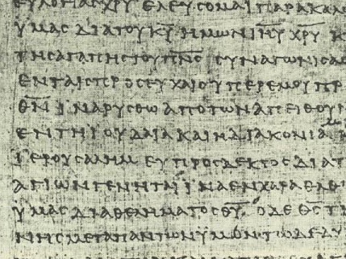
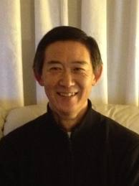

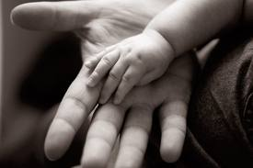
The Basis & Nature of Gifts
3
1) Charisma (ca,risma)
Roots: charis means grace (basis)
chara means joy (result)

Slide 39
GIVES
Father
is
is not
is not
GOD
“spiritual”
is
is
Son
Spirit
is not
H. Wayne House, Charts of Christian Theology and Doctrine, 45

Slide 40
Black

Slide 41
The "Who" Questions
2
Who has spiritual gifts? gives spiritual gifts? decides which gift each person should have?
Every Christian (and only Christians) has a spiritual gift (vv. 7, 11, 18).
The Holy Spirit gives the gifts (vv. 4, 7-9, 11, 18).
The Holy Spirit decides which gift each believer receives (vv. 7, 8, 10, 11).

Slide 42
APPOINTS
“There are different kinds of service,
but the same Lord” (v. 5).
Father
is
is not
is not
GOD
is
is
Son
Spirit
is not
H. Wayne House, Charts of Christian Theology and Doctrine, 45

Slide 43
The Basis & Nature of Gifts
3
2) Diakonia (dia,konia)
• Place of service (1 Cor. 12:5)
• Category of gifts (1 Pet. 4:11)
• "service" (NIV), ministries" (NASB)

Slide 44
Black

Slide 45
EMPOWERS
Father
is
is not
is not
“There are different kinds of working,
but the same GOD works all of them in all men” (v. 6).
is
is
Son
Spirit
is not
H. Wayne House, Charts of Christian Theology and Doctrine, 45

Slide 46
The Basis & Nature of Gifts
3
3) Energema (e;nerghma)
• Energy operating gifts (1 Cor. 12:6)
• "working" (NIV), "effects" (NASB)

Slide 47
Black

Slide 48

The Key Idea
Q: Where should we begin studying gifts?
A: Gifts praise the triune God--not us!

Slide 49
The Triune Involvement
EMPOWERS
Father
is
is not
is not
GOD
is
is
Son
Spirit
APPOINTS
GIVES
is not
H. Wayne House, Charts of Christian Theology and Doctrine, 45

Slide 50
The Trinity
2
The Involvement of the Whole Trinity (vv. 4-6):
God the Spirit gives (distributes) the spiritual gifts (v. 4)
God the Son assigns the place of the ministry of the gifts (v. 5)
God the Father gives the energy operative through the gifts in the place of ministry (v. 6)
(Radmacher, "Spiritual Gifts" tape, Campus Crusade for Christ)

Slide 51
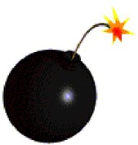
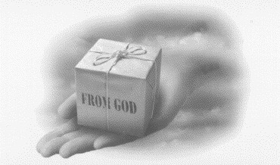
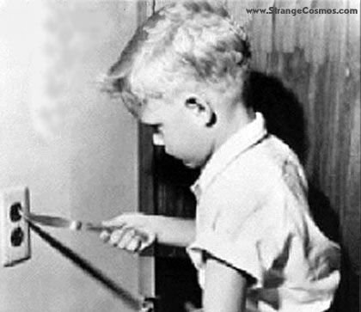
Some Dangers of
Studying Spiritual Gifts
13
SPIRITUAL GIFTS

Slide 52
Dangers of Studying Gifts
13
1) Don't think gifts are more important than fruit of the Holy Spirit (Gal. 5:22-23)

Slide 53

The Fruit of the Spirit (Gal. 5:22-23)
xliii

Slide 54
Dangers of Studying Gifts
13
1) Don't think gifts are more important than fruit of the Holy Spirit (Gal. 5:22-23)
"Doing" shouldn't replace "being"
"Service" shouldn't replace "character"

Slide 55
Dangers of Studying Gifts
13
2) Don't always reject serving in “non-gifted” areas because you don't have that gift (2 Tim. 4:5)

Slide 56
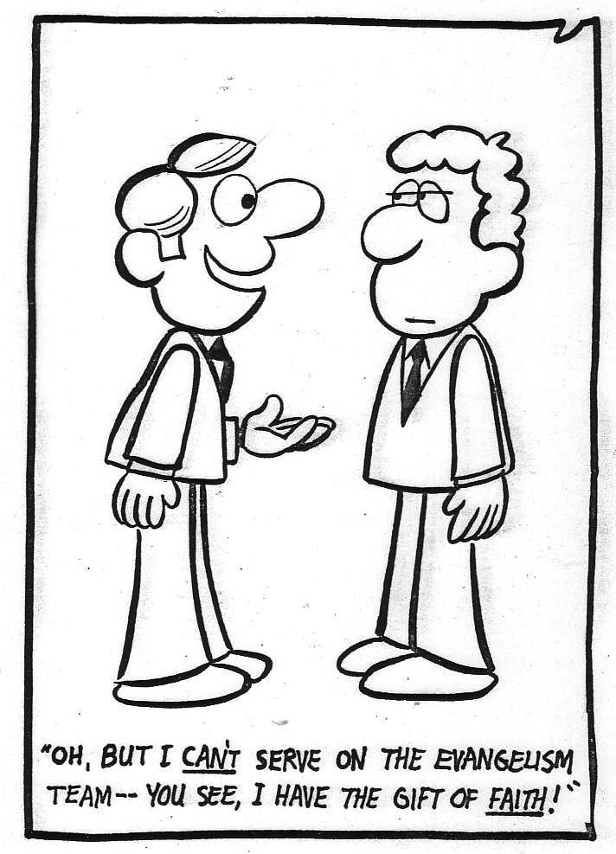
Don't reject opportunities to discern your gift!
"OH, BUT I CAN'T SERVE ON THE EVANGELISM TEAM––YOU SEE, I HAVE THE GIFT OF FAITH!"

Slide 57
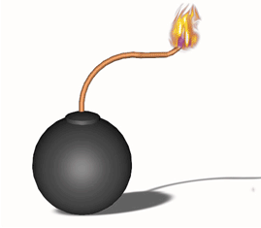
Dangers of Studying Gifts
3) Don't think that spiritual gifts are rewards for service, for holiness, for sincerity, for maturity, or for anything else!
4) Don't confuse spiritual gifts with spirituality

Slide 58
Black

Slide 59


NT Preaching link at BibleStudyDownloads.org
Get this presentation and script for free!
Notes:
NT Preaching (np)

